Slide 1

AUTOMATIC ELECTRICITY BILLING SYSTEM
Guided By: Presented By:
Dr. S. Malathi
Senior Assistant Professor Kesava Satish Boppana
Sastra Deemed University 123005064
Lakshmi Sankari G
123005076
Chandini Vantaku
123005022

Slide 2
OUTLINE
Motivation
Objectives
Significance of project
Proposed methodology
Completed work
Output pictures
Work yet to be done

Slide 3
MOTIVATION
With the current technology, There is a need to go to the meter reading room and take down readings. Thus, monitoring and keeping track records of the electricity consumption is a tedious task.
To automate this, Internet of Things can be implemented. Using The IOT can save time, electrical energy and money by collecting and automating remote data collection.

Slide 4
OBJECTIVES
This project gives real time information on your energy used for regular intervals of time allowing to better the managing of usage.
To help in increasing the transparency in billing and awareness about consumption of electricity through Blynk application (an android based interface).

Slide 5
SIGNIFICANCE
The smart meter circuit is used to measure the accurate energy consumption for customers.
With a flexible communication module, the meter provides varieties communication media for remote measuring and monitoring.

Slide 6
PROPOSED TECHNOLOGY
The connection diagram has both the Sensor, i.e. SCT-013 Current Sensor & ZMPT101B Voltage Sensor VCC is connected to Vin of ESP32 which is a 5V Supply.
The GND pin of both the modules is connected to the GND of ESP32. The output analog pin of the ZMPT101B Voltage Sensor is connected to GPIO35 of ESP32.

Slide 7
PROPOSED TECHNOLOGY
Similarly, the output analog pin of SCT-013 Current Sensor is connected to GPIO34 of ESP32. You need a two resistor of 10K & a single resistor of 100 ohms connected along with a 10uF Capacitor.
Blynk is an application that runs over Android and IOS devices to control any IoT based application using Smartphones. It allows user to create your Graphical user interface for IoT application. Here we will display the IoT Energy Meter Data on Blynk Application.

Slide 8
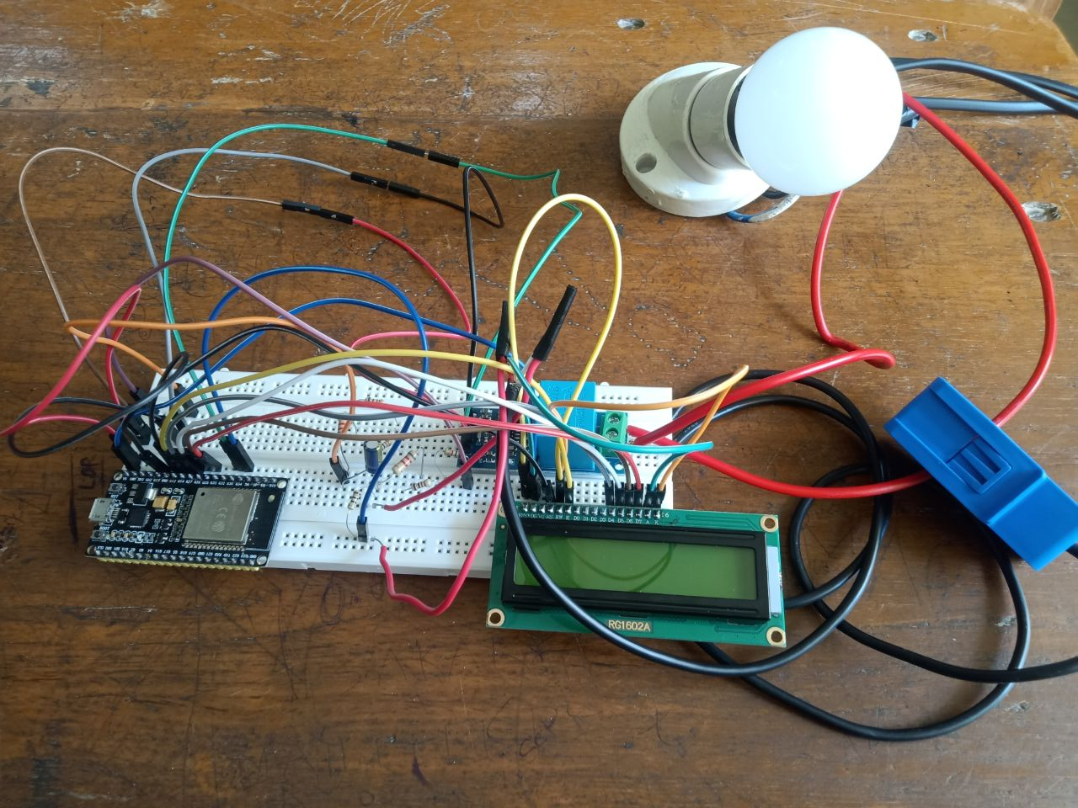
CIRCUIT PICTURE

Slide 9
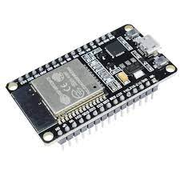
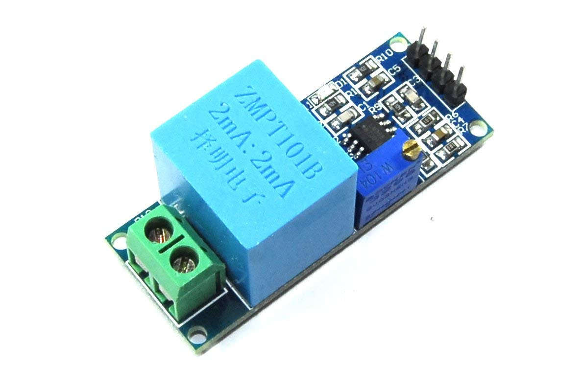
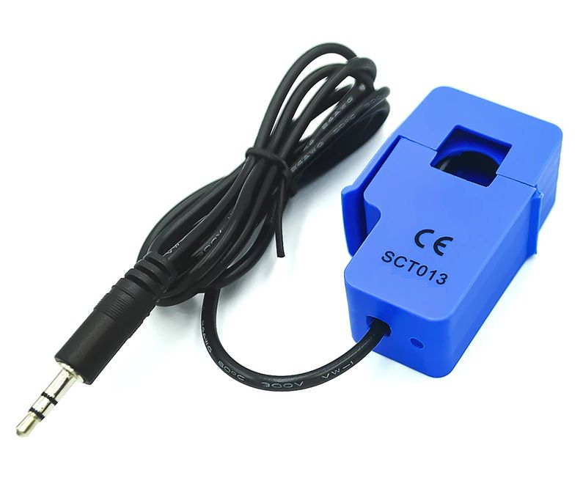
Esp-32 micro controller:
Integrated with wi-fi module also, can be connected to lcd if required.
ZMPT 101B :
Comes with voltage transformer which can be used to measure and sense voltage up to 250V
SCT013 :
Split core type current transformer which can be used to sense current up to 30 A

Slide 10
WORK YET TO BE DONE
Interfacing the circuit with the Blynk website to monitor the current, voltage and units consumed for regular intervals of time.
The code to be dumped in ESP-32 module to get the values displayed in the LCD.
Displaying the output from the circuit on Blynk app and calculation of electricity bill based on the cost per unit.

Slide 11
THANK YOU

